Slide 1
Foundations of Machine Learning
Module 7: Computational Learning Theory
Part A: Finite Hypothesis Space
Sudeshna Sarkar
IIT Kharagpur

Slide 2
Goal of Learning Theory
To understand
What kinds of tasks are learnable?
What kind of data is required for learnability?
What are the (space, time) requirements of the learning algorithm.?
To develop and analyze models
Develop algorithms that provably meet desired criteria
Prove guarantees for successful algorithms

Slide 3
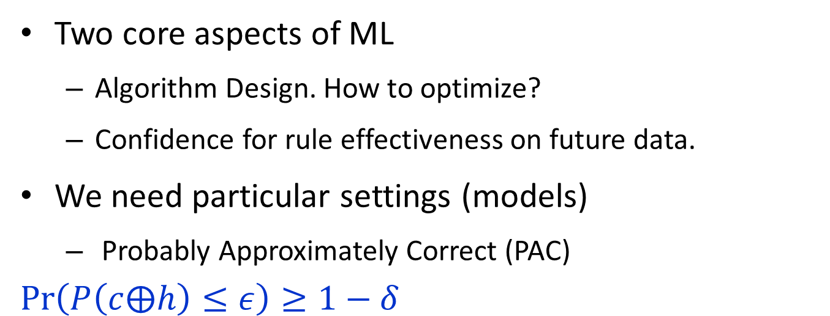
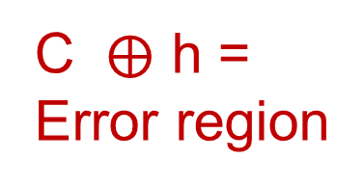
Goal of Learning Theory
Two core aspects of ML
Algorithm Design. How to optimize?
Confidence for rule effectiveness on future data.
We need particular settings (models)
Probably Approximately Correct (PAC)
$$\operatorname{Pr}\left(P\left(c⨁h\right)≤ε\right)≥1−δ$$
C
h
C $⨁$ h =
Error region

Slide 4
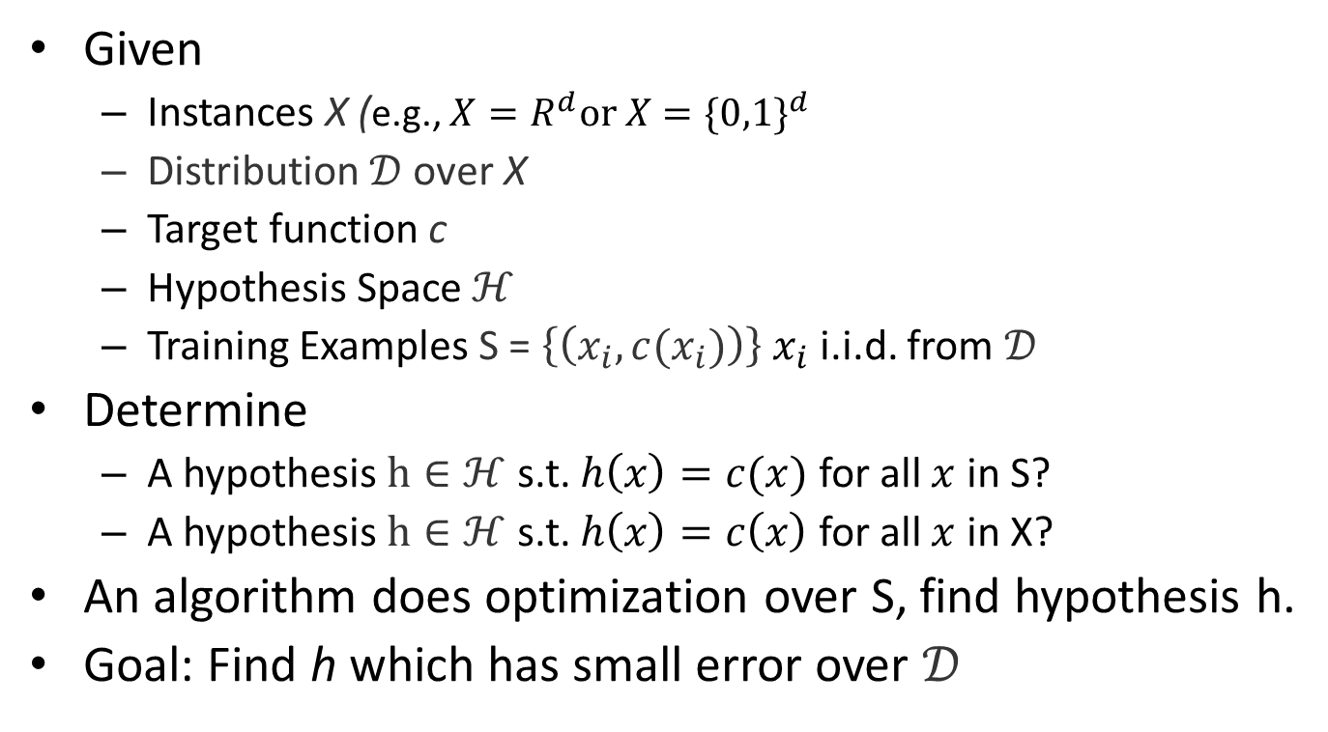

Prototypical Concept Learning Task
Given
Instances X (e.g., $X=R^{d}or X={\{0,1\}}^{d}$
Distribution $𝒟$ over X
Target function c
Hypothesis Space $ℋ$
Training Examples S = $\left\{\left(x_{i}, c(x_{i})\right)\right\}$ $x_{i}$ i.i.d. from $𝒟$
Determine
A hypothesis $h∈ℋ$ s.t. $h\left(x\right)=c(x)$ for all $x$ in S?
A hypothesis $h∈ℋ$ s.t. $h\left(x\right)=c\left(x\right)$ for all $x$ in X?
An algorithm does optimization over S, find hypothesis h.
Goal: Find h which has small error over $𝒟$
h
$$c^{}−$$
+
+
+
-
-
+
-
-
Instance space X

Slide 5

Computational Learning Theory
Can we be certain about how the learning algorithm generalizes?
We would have to see all the examples.
Inductive inference –
generalizing beyond the training
data is impossible unless we add
more assumptions (e.g.,
priors over H)
We need a bias!
h
$$c^{}−$$
+
+
+
-
-
+
-
-
Instance space X

Slide 6

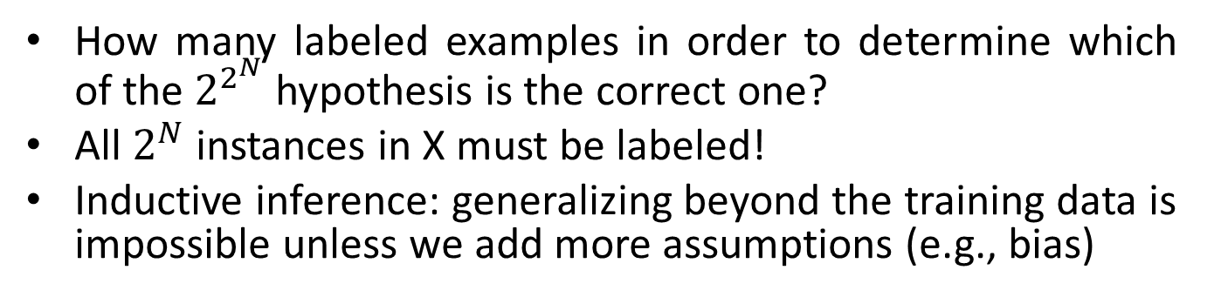
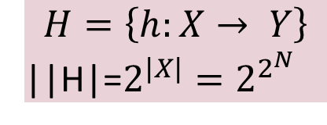

Function Approximation
How many labeled examples in order to determine which of the $2^{2^{N}}$ hypothesis is the correct one?
All $2^{N}$ instances in X must be labeled!
Inductive inference: generalizing beyond the training data is impossible unless we add more assumptions (e.g., bias)
-
$$H=\left\{h:X→ Y\right\}$$
||H|=$2^{|X|}=2^{2^{N}}$
+
$$h_{1}$$
c
+
-
+
+
-
+
-
$$h_{2}$$
Instance space X

Slide 7
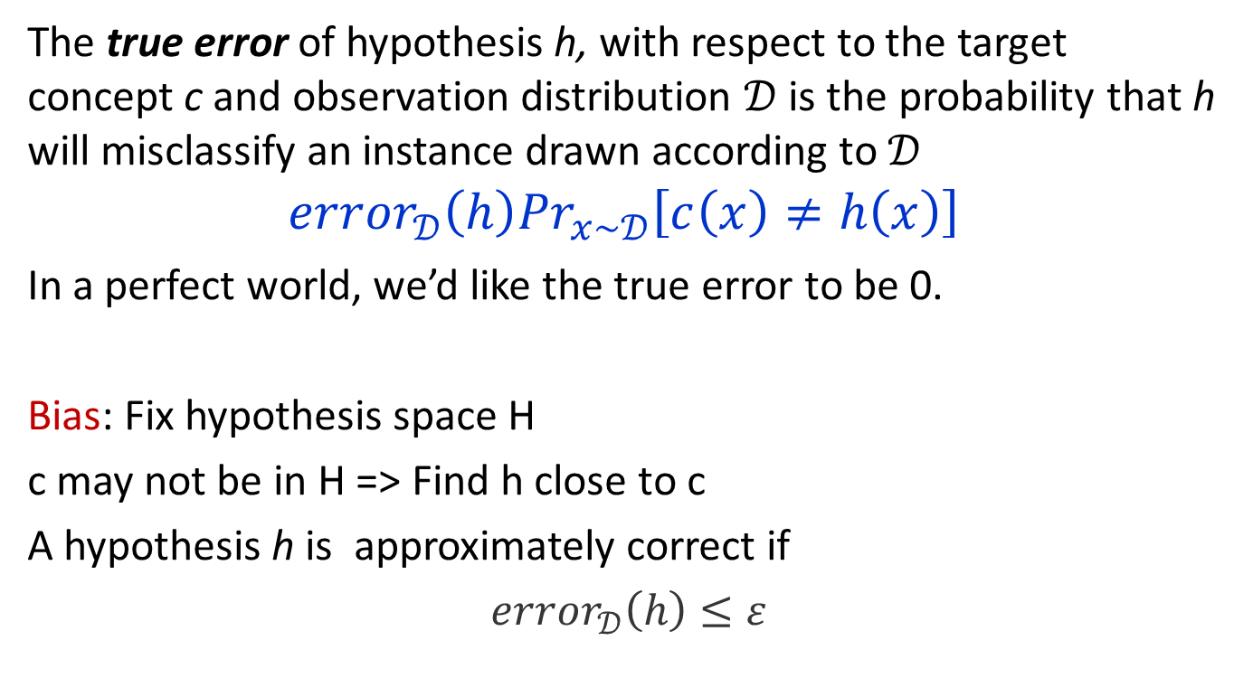
Error of a hypothesis
The true error of hypothesis h, with respect to the target concept c and observation distribution $𝒟$ is the probability that h will misclassify an instance drawn according to $𝒟$
$${error}_{𝒟}\left(h\right){Pr}_{x\sim 𝒟}\left[c\left(x\right)≠h\left(x\right)\right]$$
In a perfect world, we’d like the true error to be 0.
Bias: Fix hypothesis space H
c may not be in H => Find h close to c
A hypothesis h is approximately correct if
${error}_{𝒟}\left(h\right)≤ε$

Slide 8
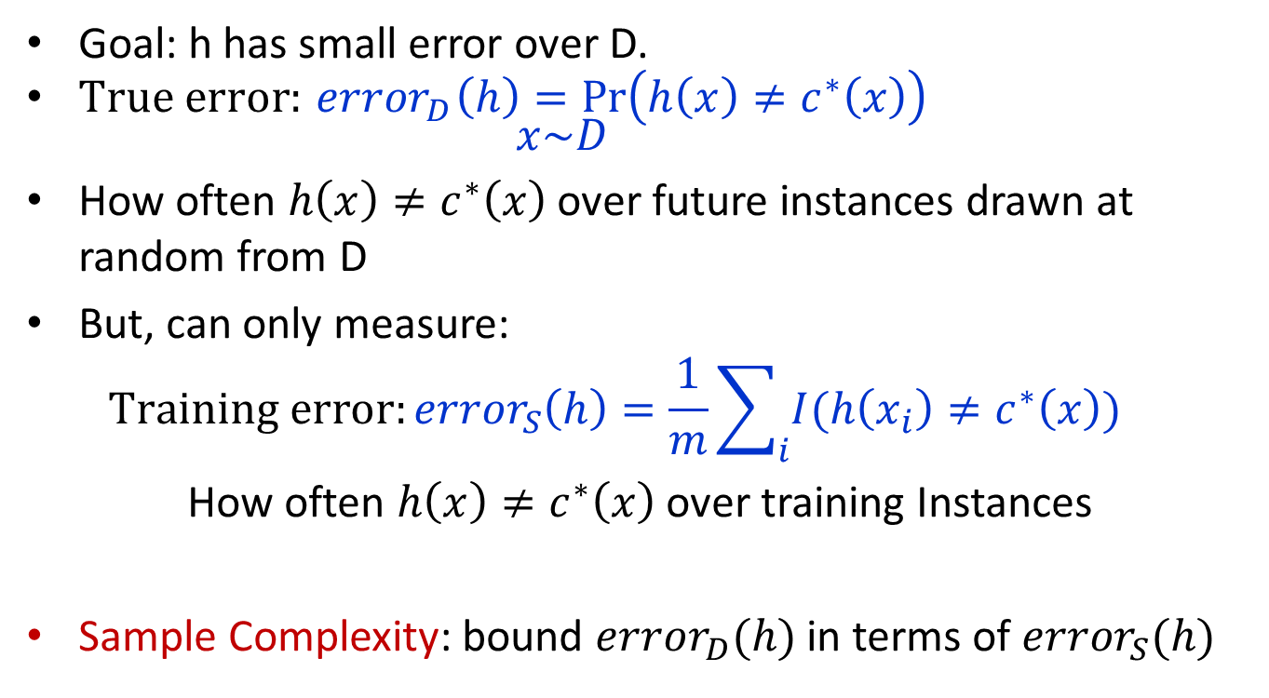
PAC model
Goal: h has small error over D.
$True error:{ error}_{D}\left(h\right)=\operatorname{Pr}\left(h\left(x\right)≠c^{∗}\left(x\right)\right)$ $x\sim D$
How often $h\left(x\right)≠c^{∗}\left(x\right)$ over future instances drawn at random from D
But, can only measure: $Training error:{error}_{S}\left(h\right)=\frac{1}{m}\sum_{i}{I(h\left(x_{i}\right)≠c^{∗}\left(x\right))}$
How often $h\left(x\right)≠c^{∗}\left(x\right)$ over training Instances
Sample Complexity: bound ${error}_{D}(h)$ in terms of ${error}_{S}(h)$

Slide 9
Probably Approximately Correct Learning
PAC Learning concerns efficient learning
We would like to prove that
With high probability an (efficient) learning algorithm will find a hypothesis that is approximately identical to the hidden target concept.
We specify two parameters, 𝜀 and 𝛿 and require that with probability at least (1−𝛿) a system learn a concept with error at most 𝜀.

Slide 10
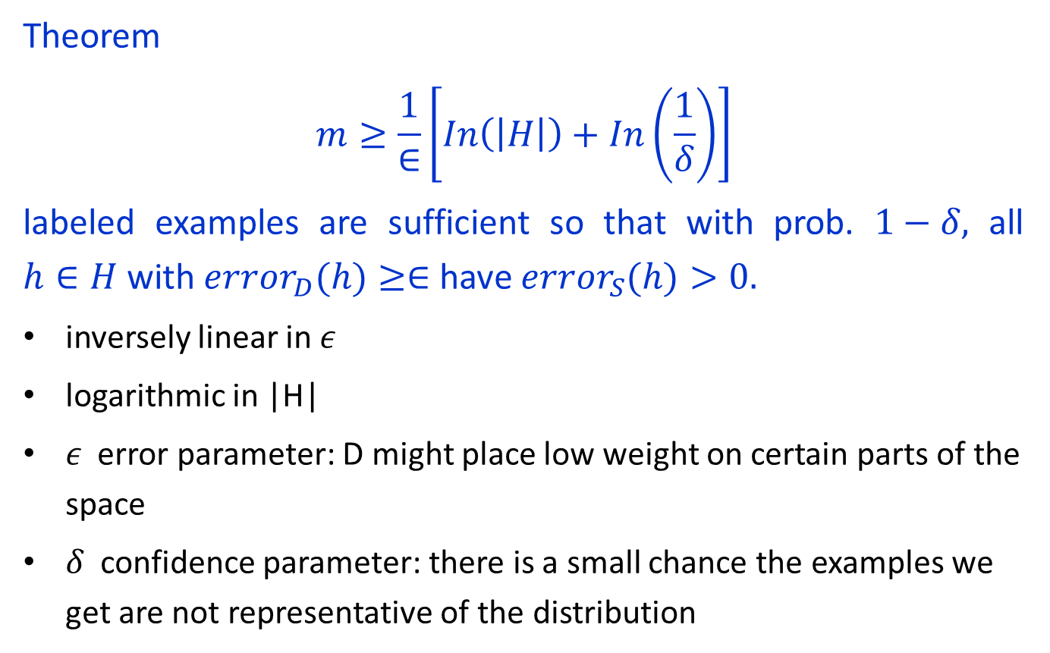
Sample Complexity for Supervised Learning
Theorem
$$m≥\frac{1}{∈}\left[In\left(\left|\left.H\right|\right.\right)+In\left(\frac{1}{δ}\right)\right]$$
labeled examples are sufficient so that with prob. $1−δ,$ all $h∈H$ with ${error}_{D}(h)≥∈$ have ${error}_{S}(h)>0.$
inversely linear in 𝜖
logarithmic in |H|
𝜖 error parameter: D might place low weight on certain parts of the space
𝛿 confidence parameter: there is a small chance the examples we get are not representative of the distribution

Slide 11
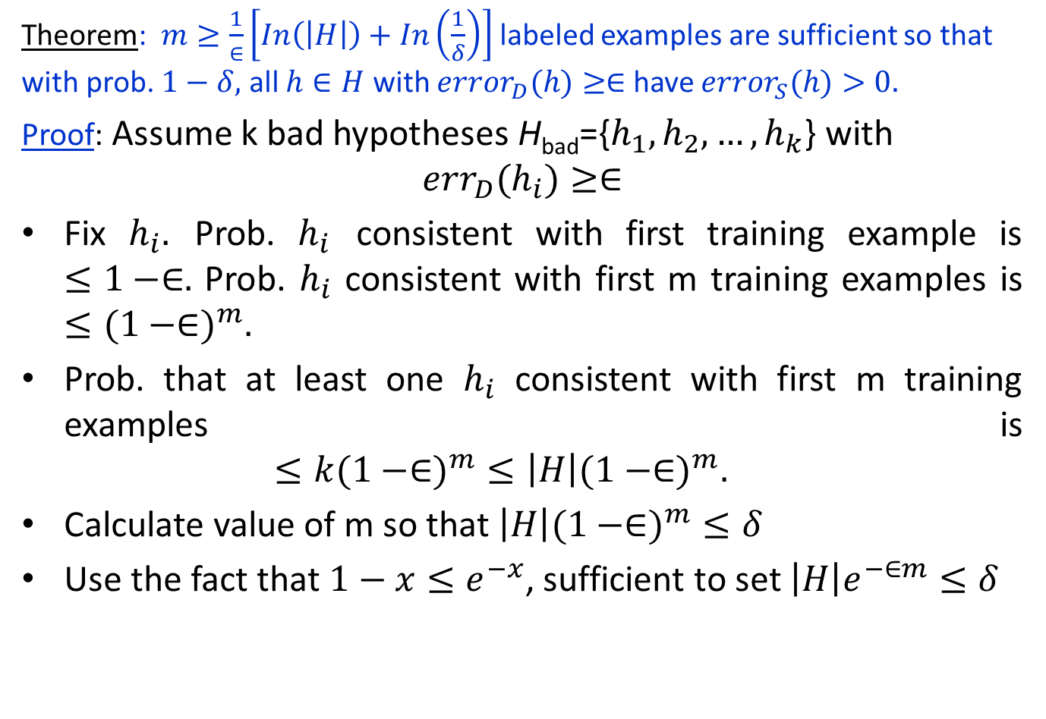
Sample Complexity for Supervised Learning
Theorem: $m≥\frac{1}{∈}\left[In\left(\left|\left.H\right|\right.\right)+In\left(\frac{1}{δ}\right)\right]$labeled examples are sufficient so that with prob. $1−δ,$ all $h∈H$ with ${error}_{D}(h)≥∈$ have ${error}_{S}(h)>0.$
Proof: Assume k bad hypotheses H_{bad}={$h_{1},h_{2},…,h_{k}$} with $${err}_{D}(h_{i})≥∈$$
Fix $h_{i}.$ Prob. $h_{i}$ consistent with first training example is $≤1−∈.$ Prob. $h_{i}$ consistent with first m training examples is $≤({1−∈)}^{m}.$
Prob. that at least one $h_{i}$ consistent with first m training examples is $≤k({1−∈)}^{m}≤\left|\left.H\right|({1−∈)}^{m}.\right.$
Calculate value of m so that $\left|\left.H\right|({1−∈)}^{m}≤δ\right.$
Use the fact that $1−x≤e^{−x}$, sufficient to set $\left|\left.H\right|e^{−∈m}≤δ\right.$

Slide 12
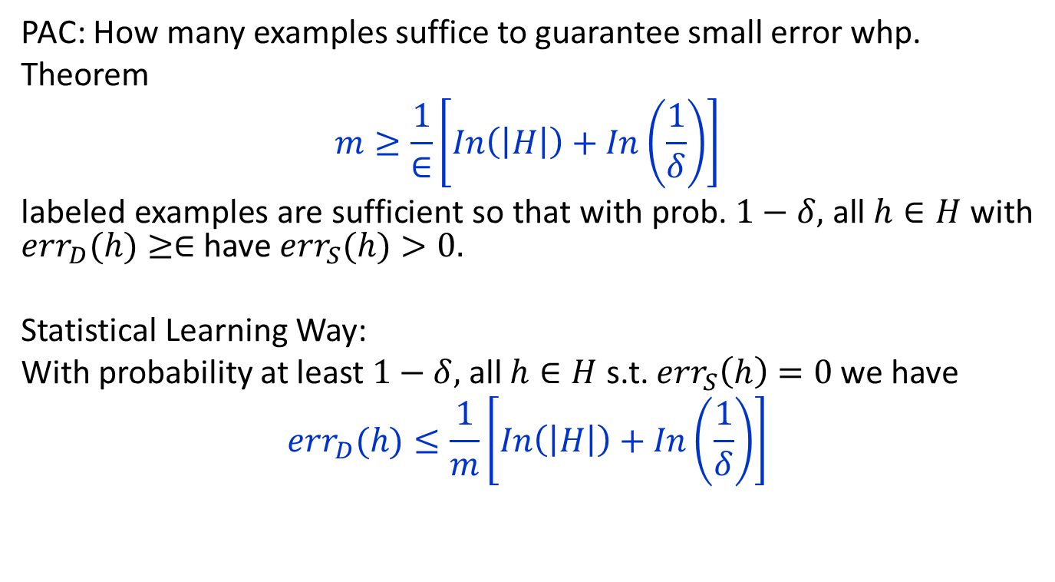
Sample Complexity: Finite Hypothesis Spaces Realizable Case
PAC: How many examples suffice to guarantee small error whp.
Theorem
$$m≥\frac{1}{∈}\left[In\left(\left|\left.H\right|\right.\right)+In\left(\frac{1}{δ}\right)\right]$$
labeled examples are sufficient so that with prob. $1−δ,$ all $h∈H$ with ${err}_{D}(h)≥∈$ have ${err}_{S}(h)>0.$
Statistical Learning Way:
With probability at least $1−δ,$ all $h∈H$ s.t. ${err}_{S}\left(h\right)=0$we have
$${err}_{D}(h)≤\frac{1}{m}\left[In\left(\left|\left.H\right|\right.\right)+In\left(\frac{1}{δ}\right)\right]$$

Slide 14
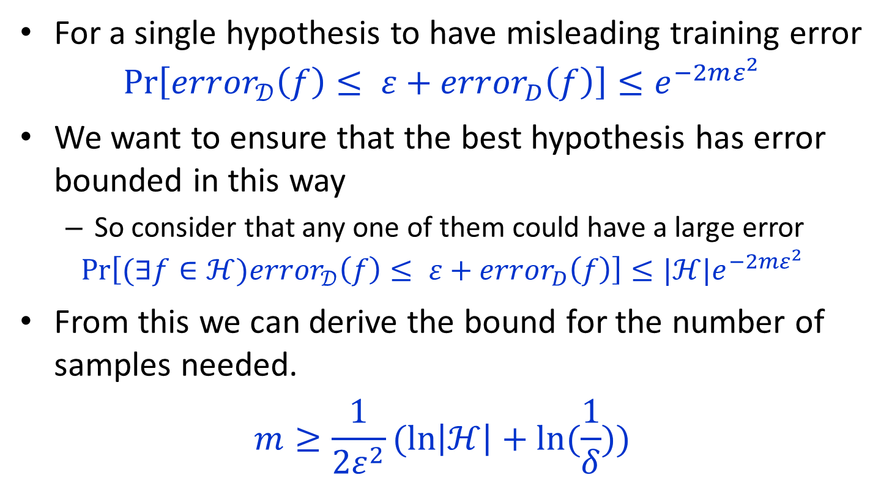

Sample complexity: inconsistent finite |$ℋ$|
For a single hypothesis to have misleading training error
$$\operatorname{Pr}\left[{error}_{𝒟}\left(f\right)≤ ε+{error}_{D}\left(f\right)\right]≤e^{−2mε^{2}}$$
We want to ensure that the best hypothesis has error bounded in this way
So consider that any one of them could have a large error
$$\operatorname{Pr}\left[(∃f∈ℋ){error}_{𝒟}\left(f\right)≤ ε+{error}_{D}\left(f\right)\right]≤{|ℋ|e}^{−2mε^{2}}$$
From this we can derive the bound for the number of samples needed.
$$m≥\frac{1}{2ε^{2}}(\ln\left|ℋ\right|+\ln{(\frac{1}{δ})})$$

Slide 15
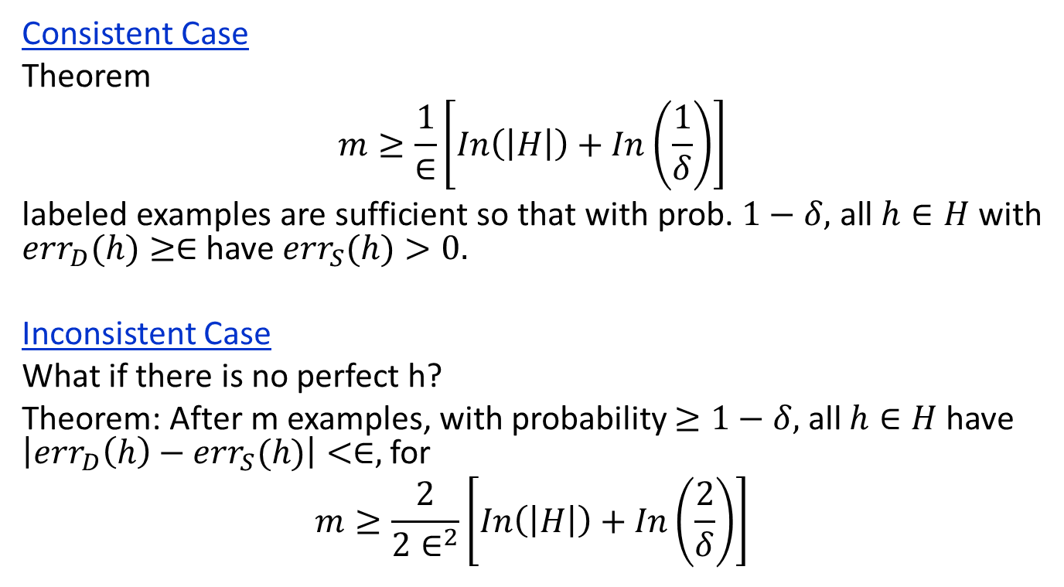
Sample Complexity: Finite Hypothesis Spaces
Consistent Case
Theorem
$$m≥\frac{1}{∈}\left[In\left(\left|\left.H\right|\right.\right)+In\left(\frac{1}{δ}\right)\right]$$
labeled examples are sufficient so that with prob. $1−δ,$ all $h∈H$ with ${err}_{D}(h)≥∈$ have ${err}_{S}(h)>0.$
Inconsistent Case
What if there is no perfect h?
Theorem: After m examples, with probability $≥1−δ,$ all $h∈H$have $\left|{err}_{D}\left(h\right)−{err}_{S}(h)\right|<∈,$ for
$$m≥\frac{2}{{2∈}^{2}}\left[In\left(\left|\left.H\right|\right.\right)+In\left(\frac{2}{δ}\right)\right]$$

Slide 16
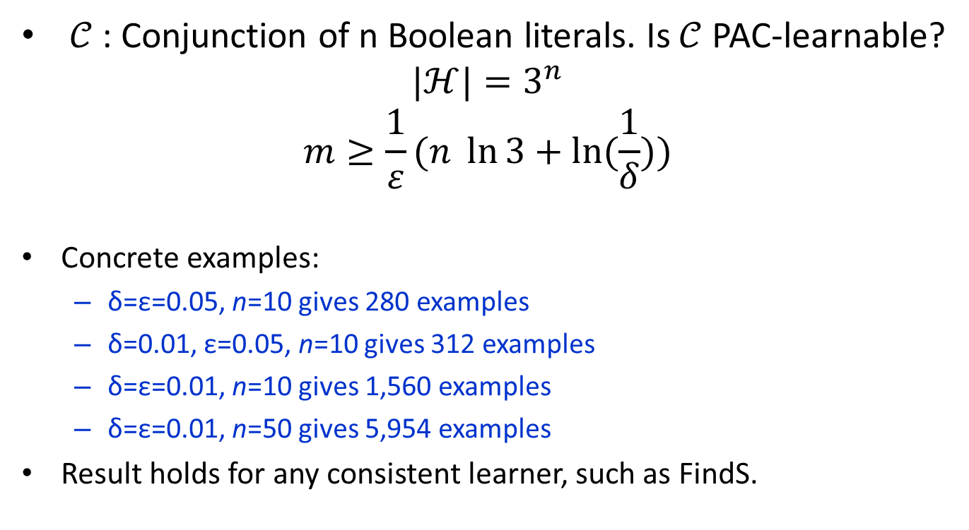
Sample complexity: example
$𝒞$ : Conjunction of n Boolean literals. Is $𝒞$ PAC-learnable?
$$|ℋ|{=3}^{n}$$
$$m≥\frac{1}{ε}(n \ln{3}+\ln{(\frac{1}{δ}))}$$
Concrete examples:
δ=ε=0.05, n=10 gives 280 examples
δ=0.01, ε=0.05, n=10 gives 312 examples
δ=ε=0.01, n=10 gives 1,560 examples
δ=ε=0.01, n=50 gives 5,954 examples
Result holds for any consistent learner, such as FindS.
Notes:
Eps = .1 n = 3, del =.05 gives m>=140

Slide 17
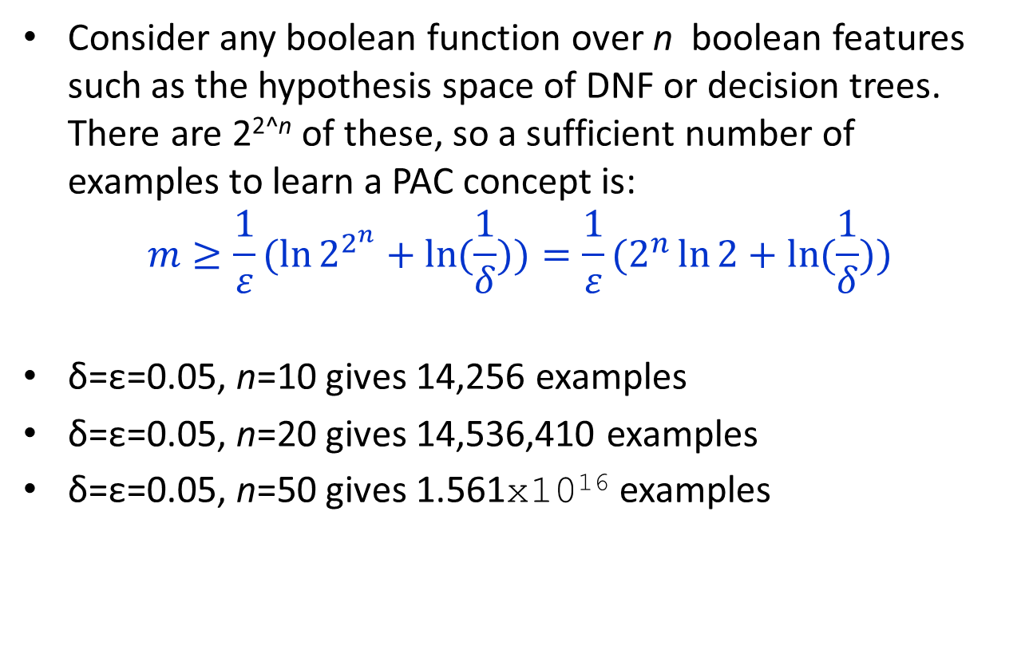
Sample Complexity of Learning Arbitrary Boolean Functions
Consider any boolean function over n boolean features such as the hypothesis space of DNF or decision trees. There are 2^{2^n} of these, so a sufficient number of examples to learn a PAC concept is:
$$m≥\frac{1}{ε}(\ln{2^{2^{n}}}+\ln{(\frac{1}{δ}))}=\frac{1}{ε}(2^{n}\ln{2}+\ln{(\frac{1}{δ}))}$$
δ=ε=0.05, n=10 gives 14,256 examples
δ=ε=0.05, n=20 gives 14,536,410 examples
δ=ε=0.05, n=50 gives 1.561x10¹⁶ examples

Slide 18
Thank You

Slide 19
Concept Learning Task
“Days in which Aldo enjoys swimming”
Hypothesis Representation: Conjunction of constraints on the 6 instance attributes
“?” : any value is acceptable
specify a single required value for the attribute
“∅” : that no value is acceptable

Slide 20
Concept Learning
h = (?, Cold, High, ?, ?, ?)
indicates that Aldo enjoys his favorite sport on cold days with high humidity
Most general hypothesis: (?, ?, ?, ?, ?, ? )
Most specific hypothesis: (∅, ∅, ∅, ∅, ∅, ∅)

Slide 21
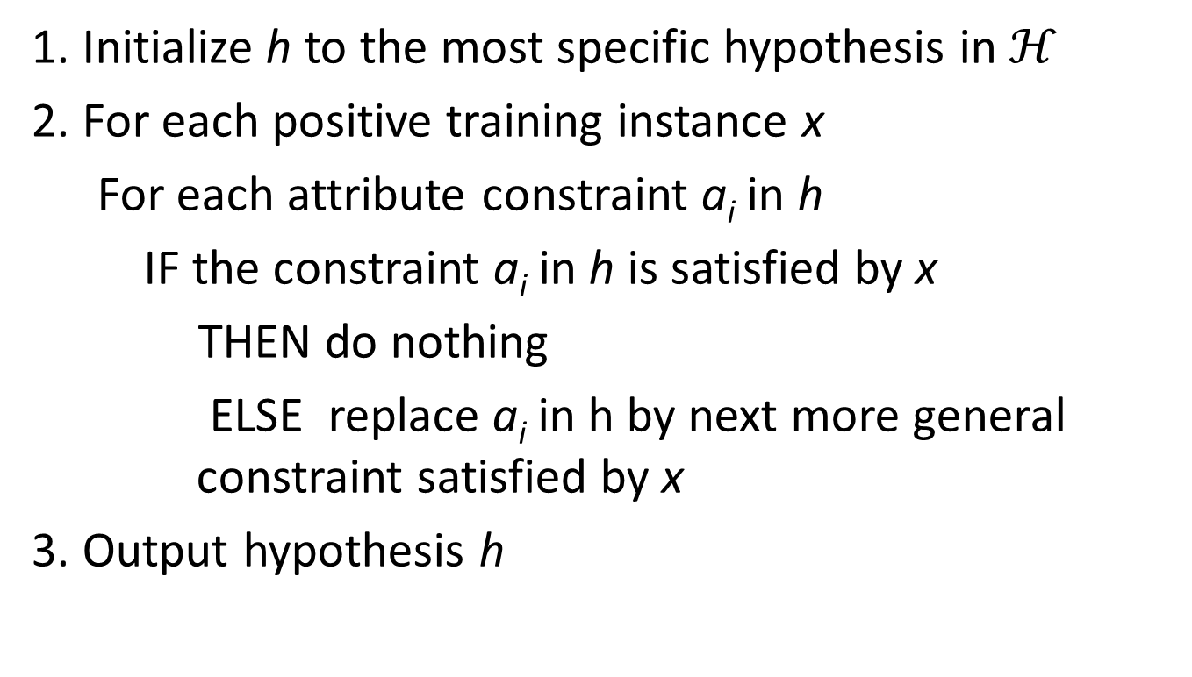
Find-S Algorithm
1. Initialize h to the most specific hypothesis in $ℋ$
2. For each positive training instance x
For each attribute constraint a_{i} in h
IF the constraint a_{i} in h is satisfied by x
THEN do nothing
ELSE replace a_{i} in h by next more general constraint satisfied by x
3. Output hypothesis h

Slide 22
Concept Learning
Finding a Maximally Specific Hypothesis
Find-S Algorithm
h₁ ← (∅, ∅, ∅, ∅, ∅, ∅)
h₂ ← (Sunny, Warm, Normal, Strong, Warm, Same)
h₃ ← (Sunny, Warm, ?, Strong, Warm, Same)
h₄ ← (Sunny, Warm, ?, Strong, ?, ?)
Back

Slide 23
Thank You

